Slide 1
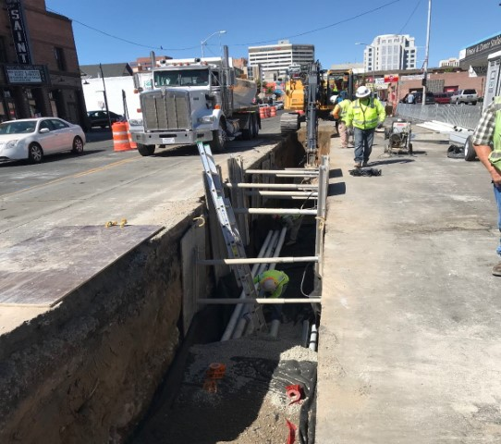
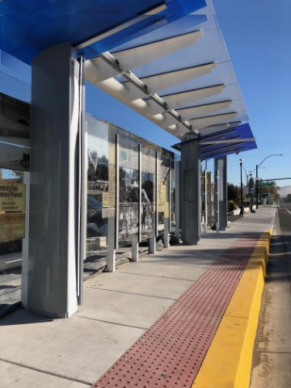
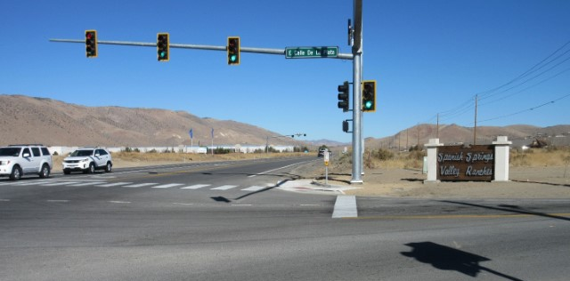
City of Sparks & RTC
Interlocal Cooperative Agreement FY 20
April 20, 2018

Slide 2
Project Development Process
2040 Regional Transportation Plan (RTP)
10 Year Capital Improvement Program (CIP)
5 Year Regional Transportation Improvement Program (RTIP)
Program of Projects (POP)
Budget
Project Delivery

Slide 3
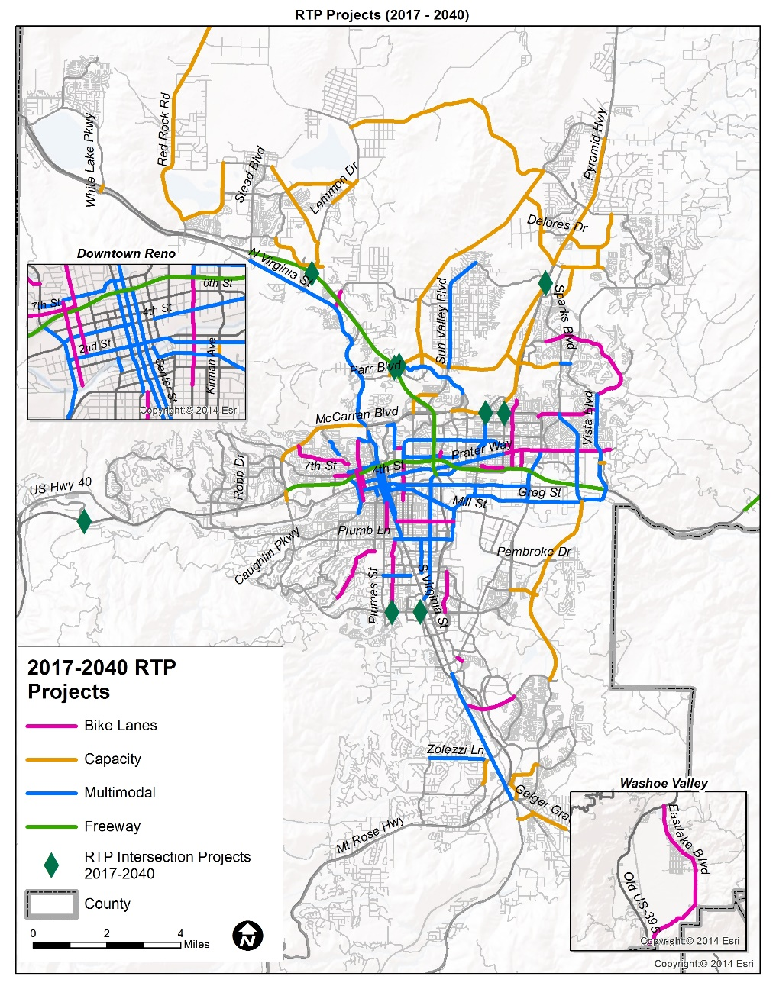
Project Implementation Process
Projects recommended by RTC TAC and CMAC, approved by RTC Board
Program of Projects reviewed by and input obtained from Reno, Sparks, Washoe County
Washoe County authorizes projects funded with fuel tax
Interlocal Cooperative Agreement (ICA) executed for implementation
Insert RTP map here of all projects 2017-2040

Slide 4
Fuel Tax used for Streets & Highways
RTC evaluates and approves fuel tax funded projects in terms of the criteria in NRS 373.140(2):
The priorities established by the Regional Transportation Plan
The relation of the proposed work to other projects already constructed or authorized
The relative need for the project in comparison to others proposed
The money available
The Board of County Commissioners then authorizes the projects. NRS 373.140(2)
ICA’s approved at City Council

Slide 5
 | NEW PROJECTS FOR FY2020
 | Prelim Project Est. Total | Proposed Years of Construction | Work Phase | ICA Required
 | Dollars | Calendar Year | For FY 2020 | Jurisdiction
FOREST STREET BIKE FACILITY | $4,100,000 | 2021 | Design | COR
LEMMON DRIVE | $15,300,000 | 2023-2024 | Design | COR,County
SPAGHETTI BOWL (SBX)* | $150,000,000* | 2019-2022 | Design, Construction | NDOT
SPARKS BLVD | $57,800,000 | 2023 | Design | COS
SIERRA STREET IMPROVEMENTS | $4,400,000 | 2021 | Design | COR
WEST 4th STREET | $8,000,000 | 2022 | Design | COR
2020 Preventative Maintenance (2019/2020) | $7,500,000 | 2020/2021 | Design, Construction | ALL
2020 Roadway Reconstruction Projects (2019/2020) | $8,500,000 | 2020/2021 | Design, Construction | ALL
TE SPOT 9 INTERSECTION IMPROVEMENTS | $3,500,000 | 2020/2021 | Design, Construction | NA
TRAFFIC MANAGEMENT PROGRAM/ITS/LiDAR | $1,450,000 | 2020/2021 | Design, Construction | ALL
ADA ACCESS TRANSIT/PEDESTRIAN CONNECTIVITY | $2,000,000 | 2020/2021 | Design, Construction | ALL
Programs
New Projects
* RTC Funding to be $30M Total over 3 Fiscal Years

Slide 6
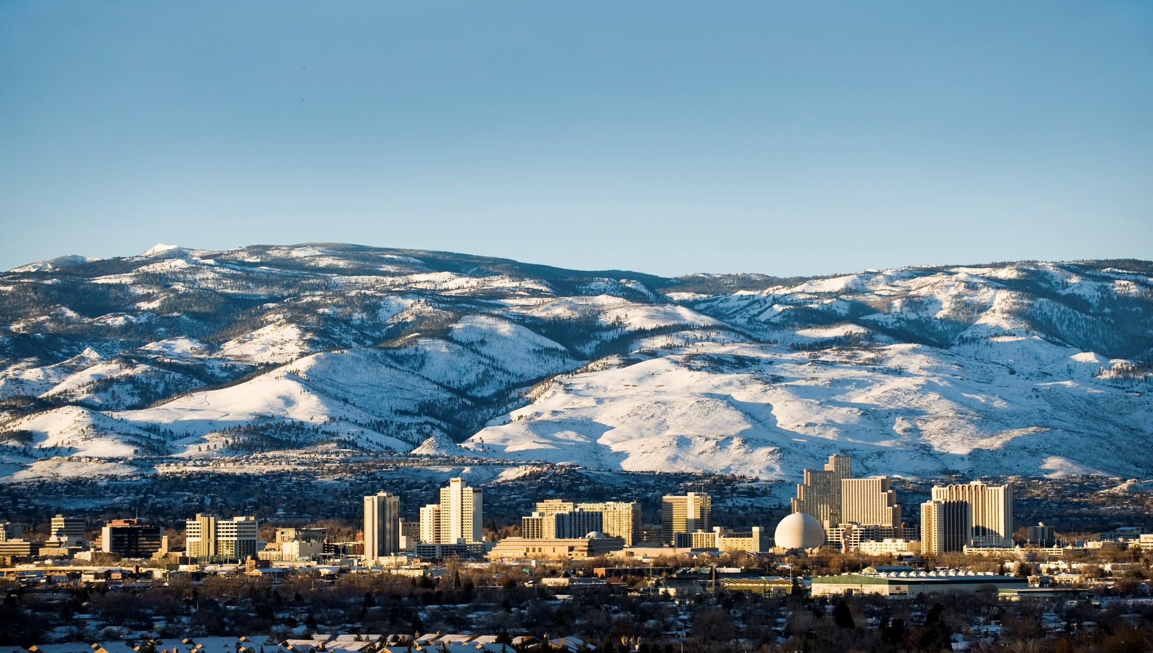
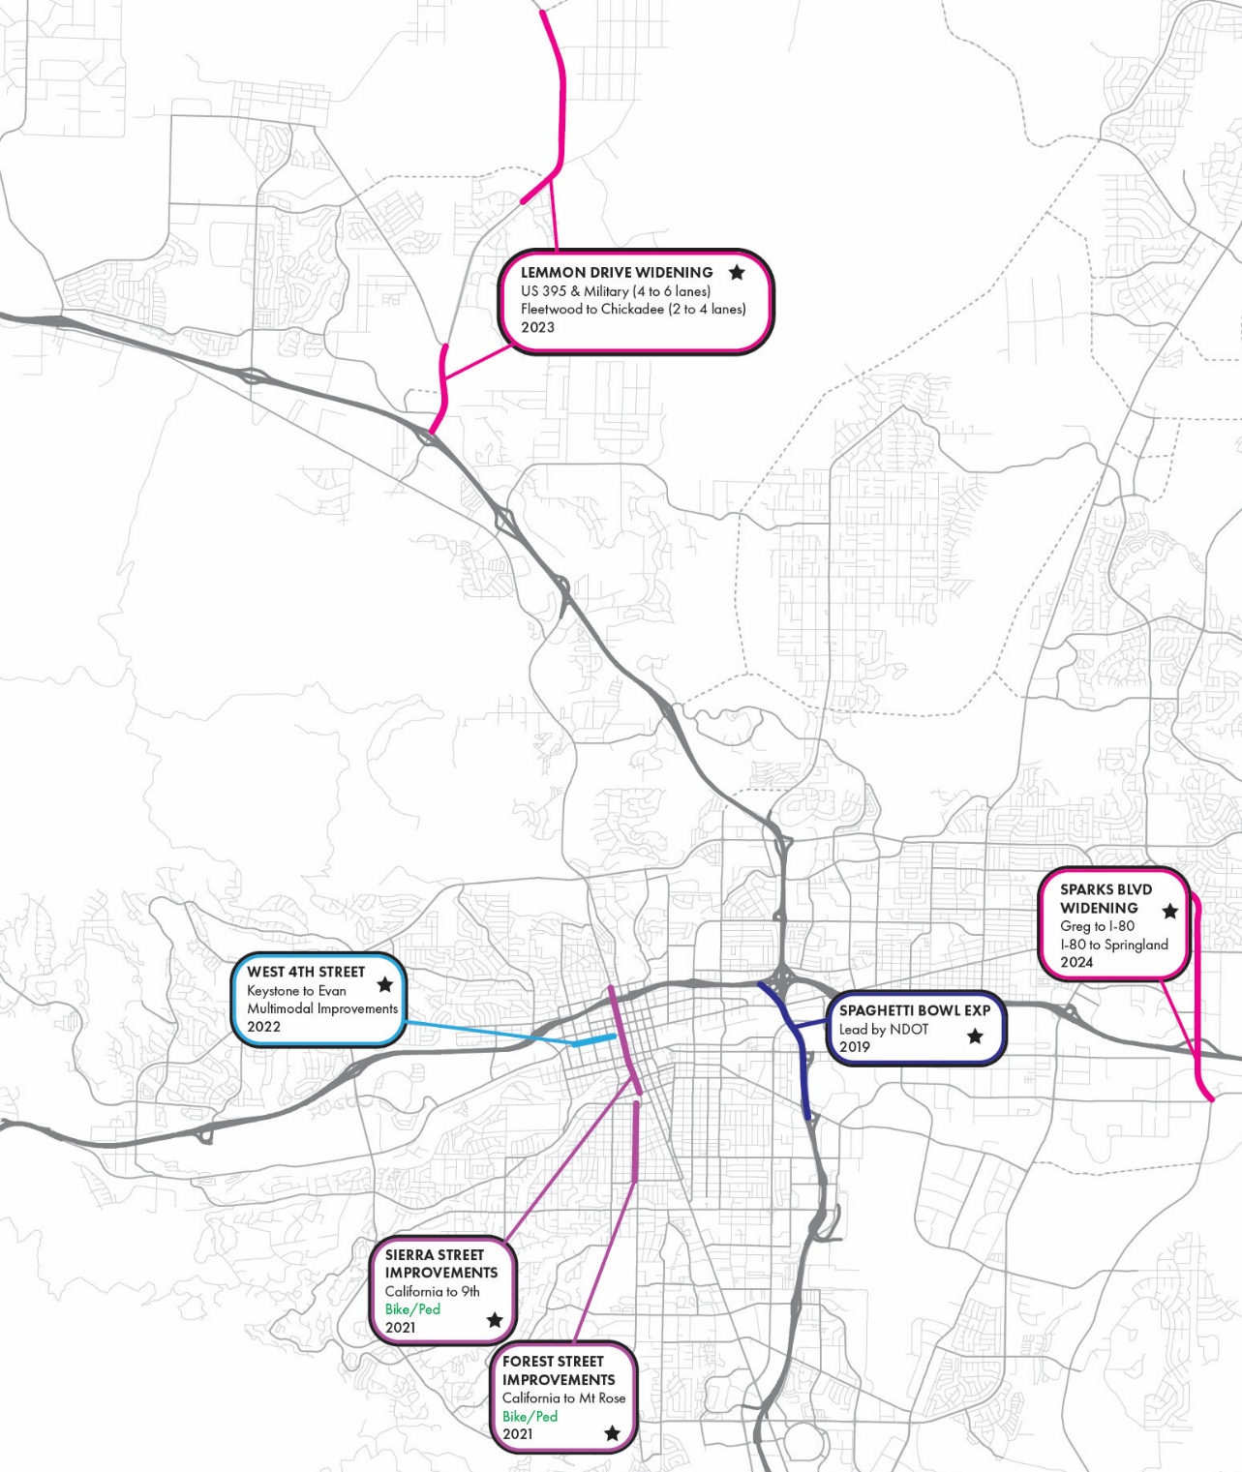
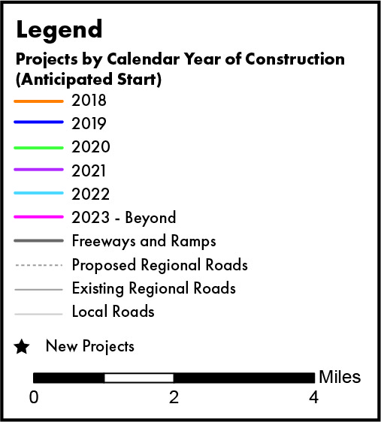
New Projects

Slide 7
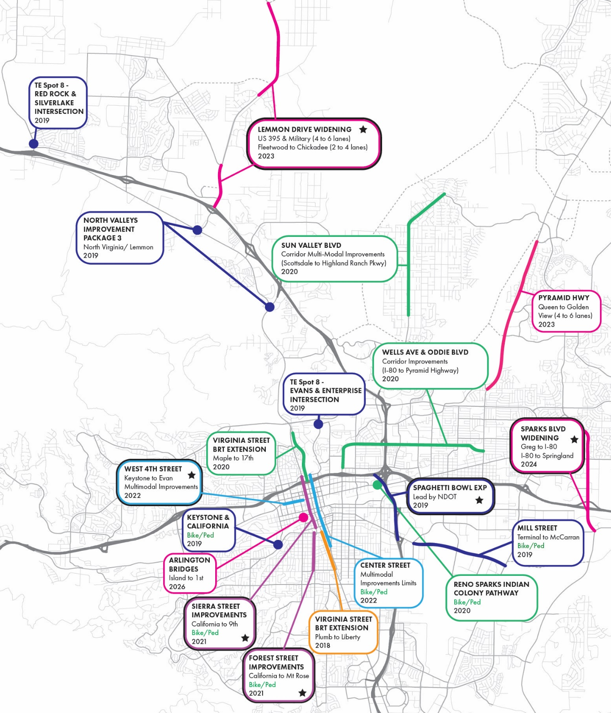
Existing Projects and Programs

Slide 8
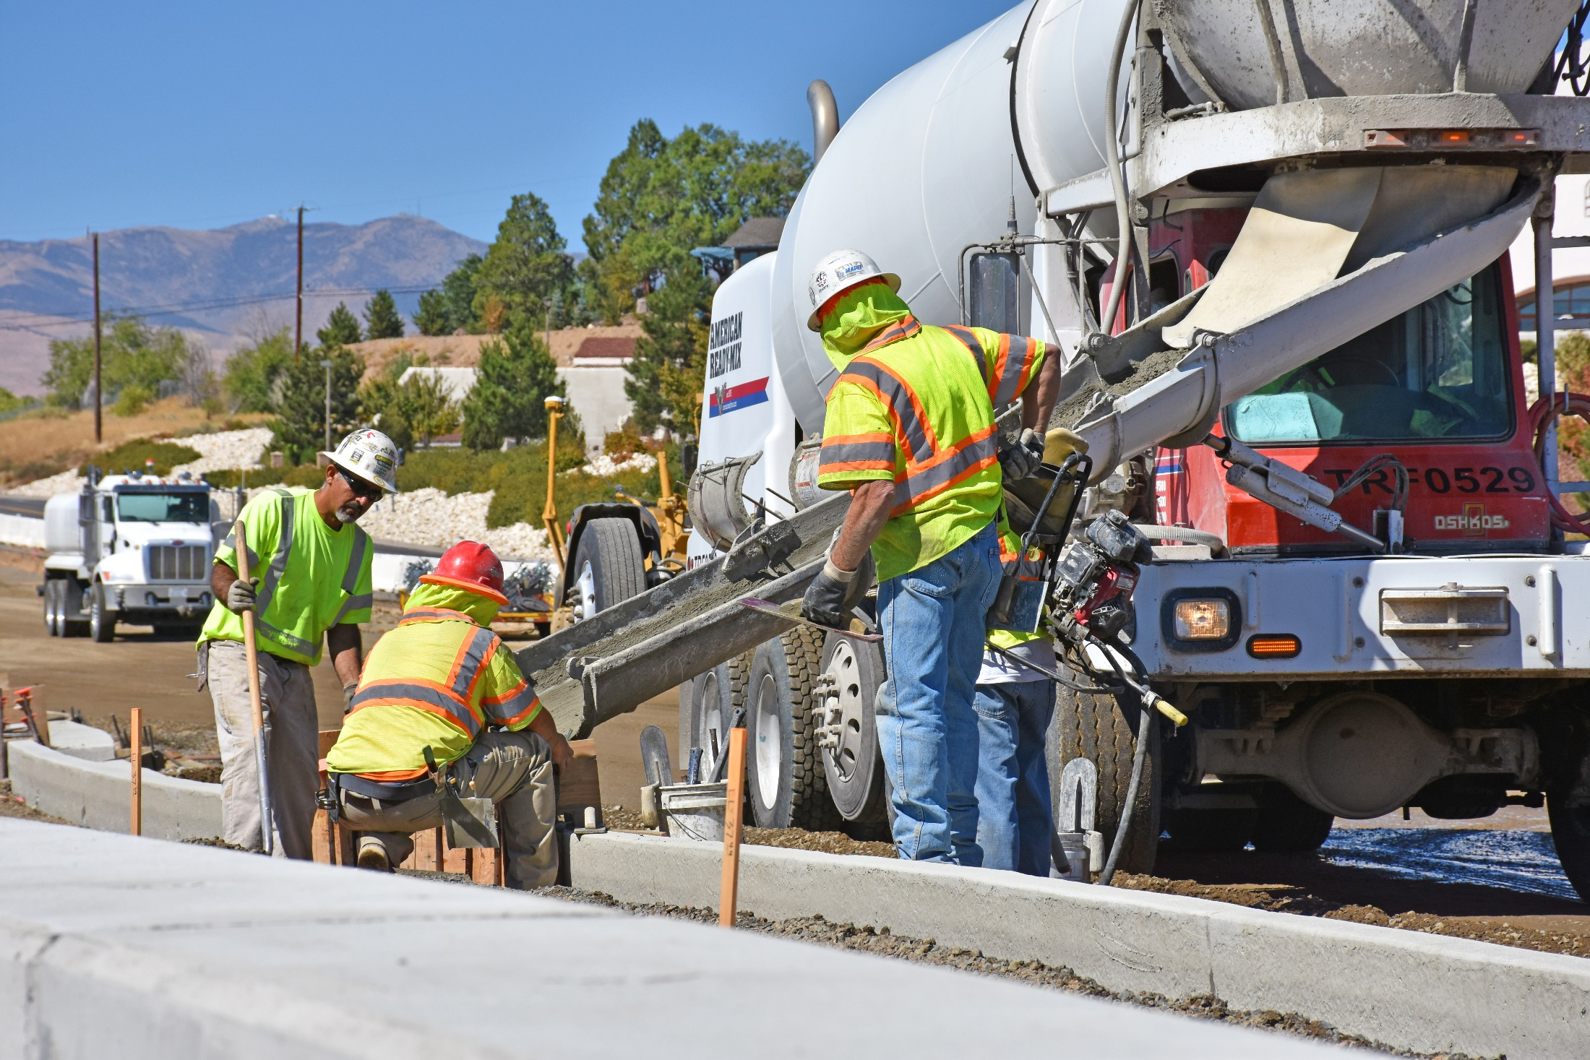
Project Selection Process for Pavement Preservation Program
RTC follows a performance-based, data-driven planning process:
Group category included in RTP for pavement preservation
($16m in FY 2020)
Pavement condition data provided by jurisdictions
Projects prioritized based on pavement condition and traffic volumes
The Pavement Preservation team recommends a project list
Team includes staff from Reno, Sparks, Washoe County, and RTC

Slide 9
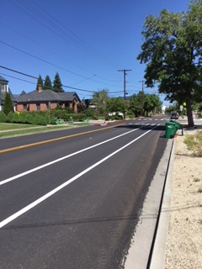
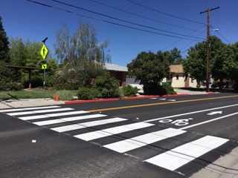
Project Selection Process for Bicycle, Pedestrian & ADA Projects
RTC implements a performance-based, data-driven planning process:
Group category included in RTP for smaller bike/ped/ADA projects
Projects identified and prioritized in the Bicycle and Pedestrian Master Plan
Identified in an existing plan
Located on regional road or connect to existing facility
Eliminate gap in connectivity
Connect to transit
Located near essential services (school, social services,
affordable housing, medical services)
High density area
Constructability

Slide 10
Bus Stop & Connectivity Locations
2019

Slide 11
Traffic Engineering Project Selection
Local Agency Requests
Review Traffic Signal Warrants
Establish Project Priorities (TOMS*)
Identify Funding Availability
FY Budget approved
Consultant Design
Right of way, if needed
Construction
*TOMS (Traffic Operations Committee members include local government staff and NDOT staff
Project scopes range from new signals, adding turn lanes, adding battery back up systems, adding a flashing yellow arrow
Notes:
Process for selecting intersection improvements, typically one year project length

Slide 12
Questions & Discussion
Brian Stewart, P.E.
Director of Engineering
bstewart@rtcwashoe.com
Thank you!
Your RTC. Our Community.

